Slide 1



The adaptive role of social learning in the exploration of uncertain environments
Lab meeting
25.04.2024
Simon Ciranka,
MPI Berlin
Wouter van den Bos,
UvA
Notes:
A bit conceptual

Slide 2
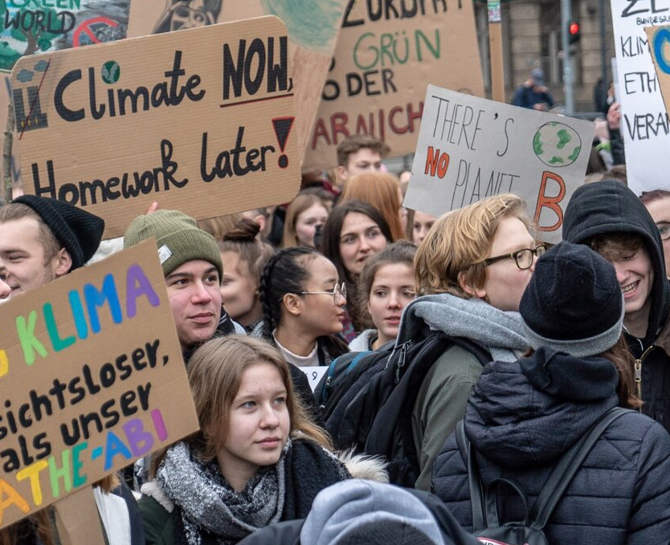
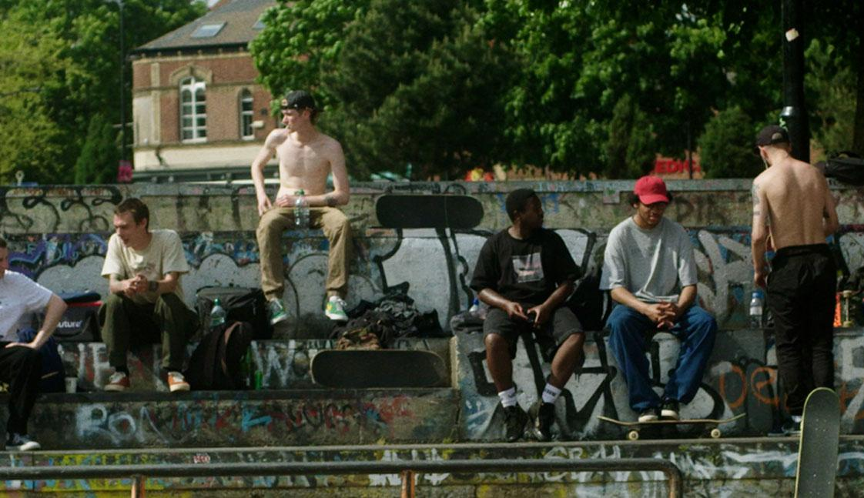

Social influence is double-edged sword
Notes:
In dev psychology, social influence has a bad reputation.

Slide 3
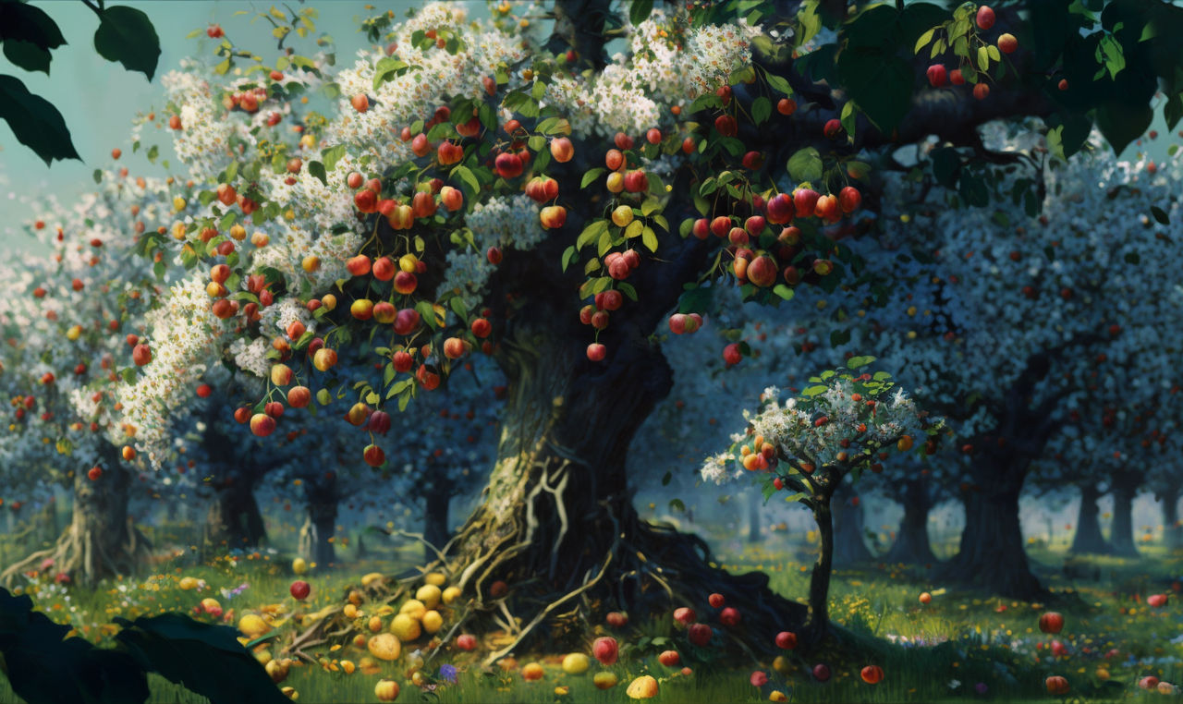

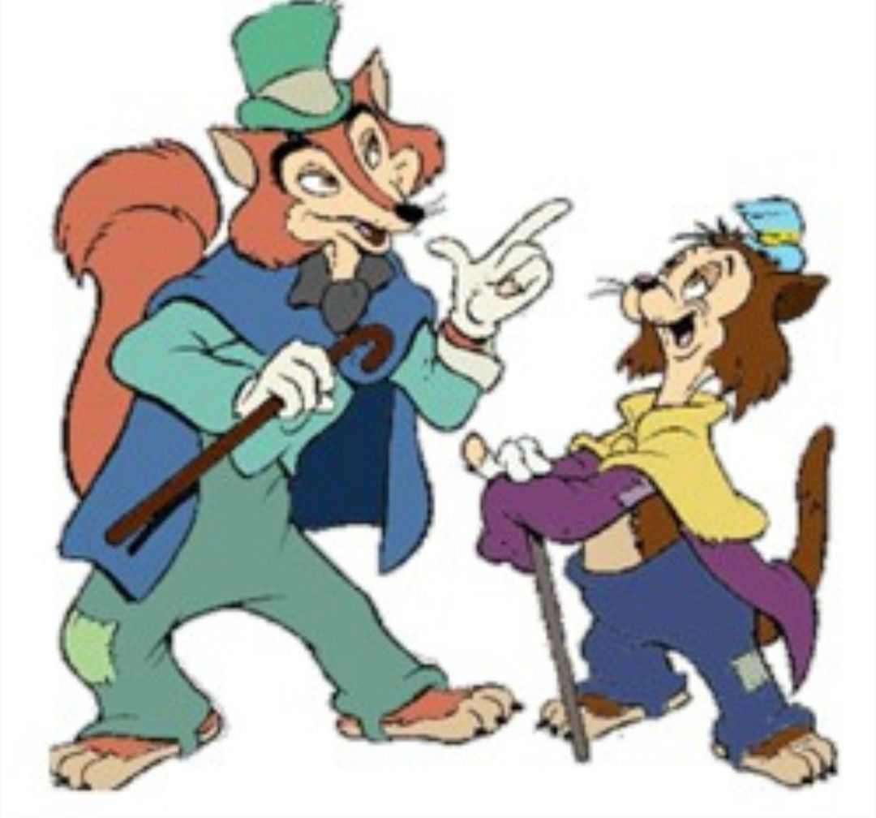

It all depends…
… on the “environment”…
… and who you follow.

Slide 4
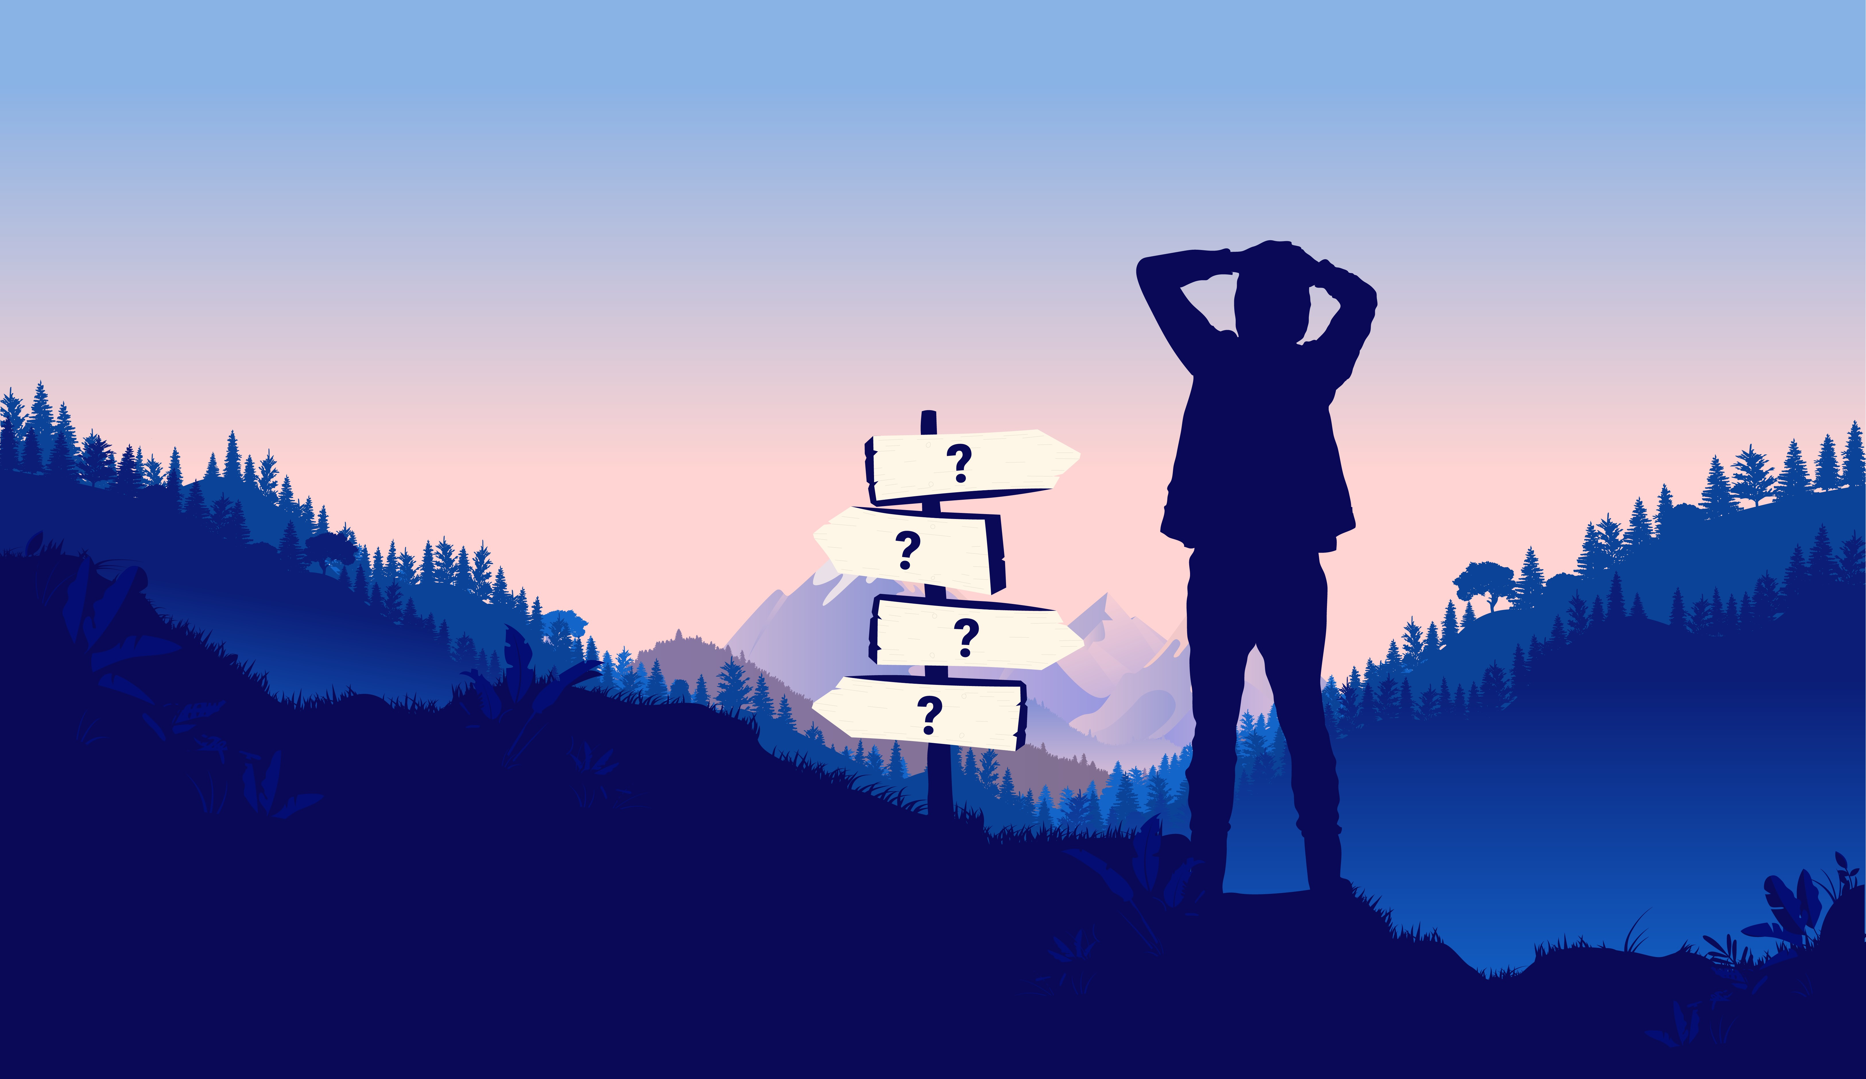
Environmental changes in adolescence
Forming an identity,
developing relationships,
becoming independent: more uncertainty
Notes:
Why is interesting to look at social influence/learing in adolescence?
Time of change. The world becomes larger, simply by that, behavior becomes increasingly more exploratory

Slide 5
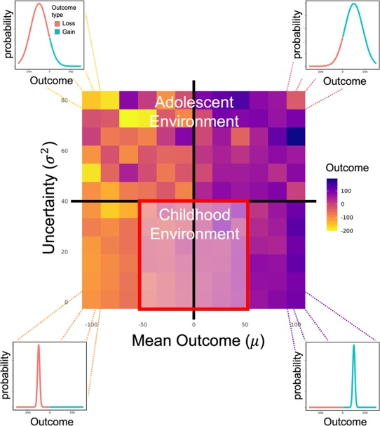
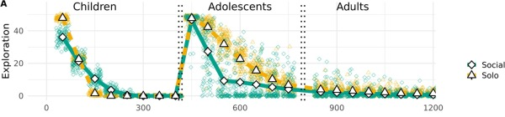
The world becomes more complex
Simply because they had more options, agents explored more and took more risks.
Ciranka & van den Bos,
Developmental Review, 2021
Notes:
The idea that a change in the environment triggers changes in behavior has been explored in this study by… where

Slide 6
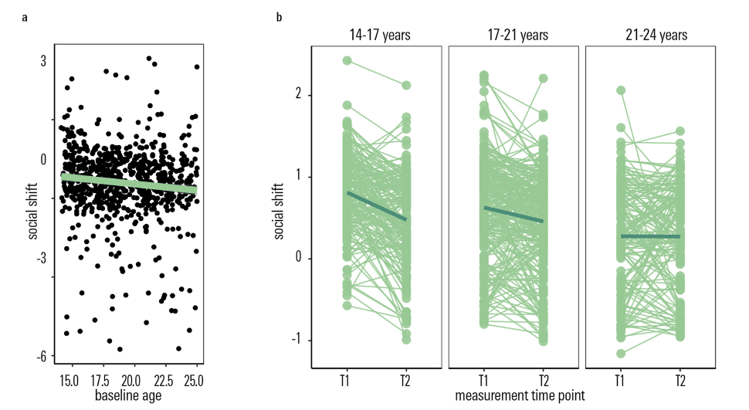
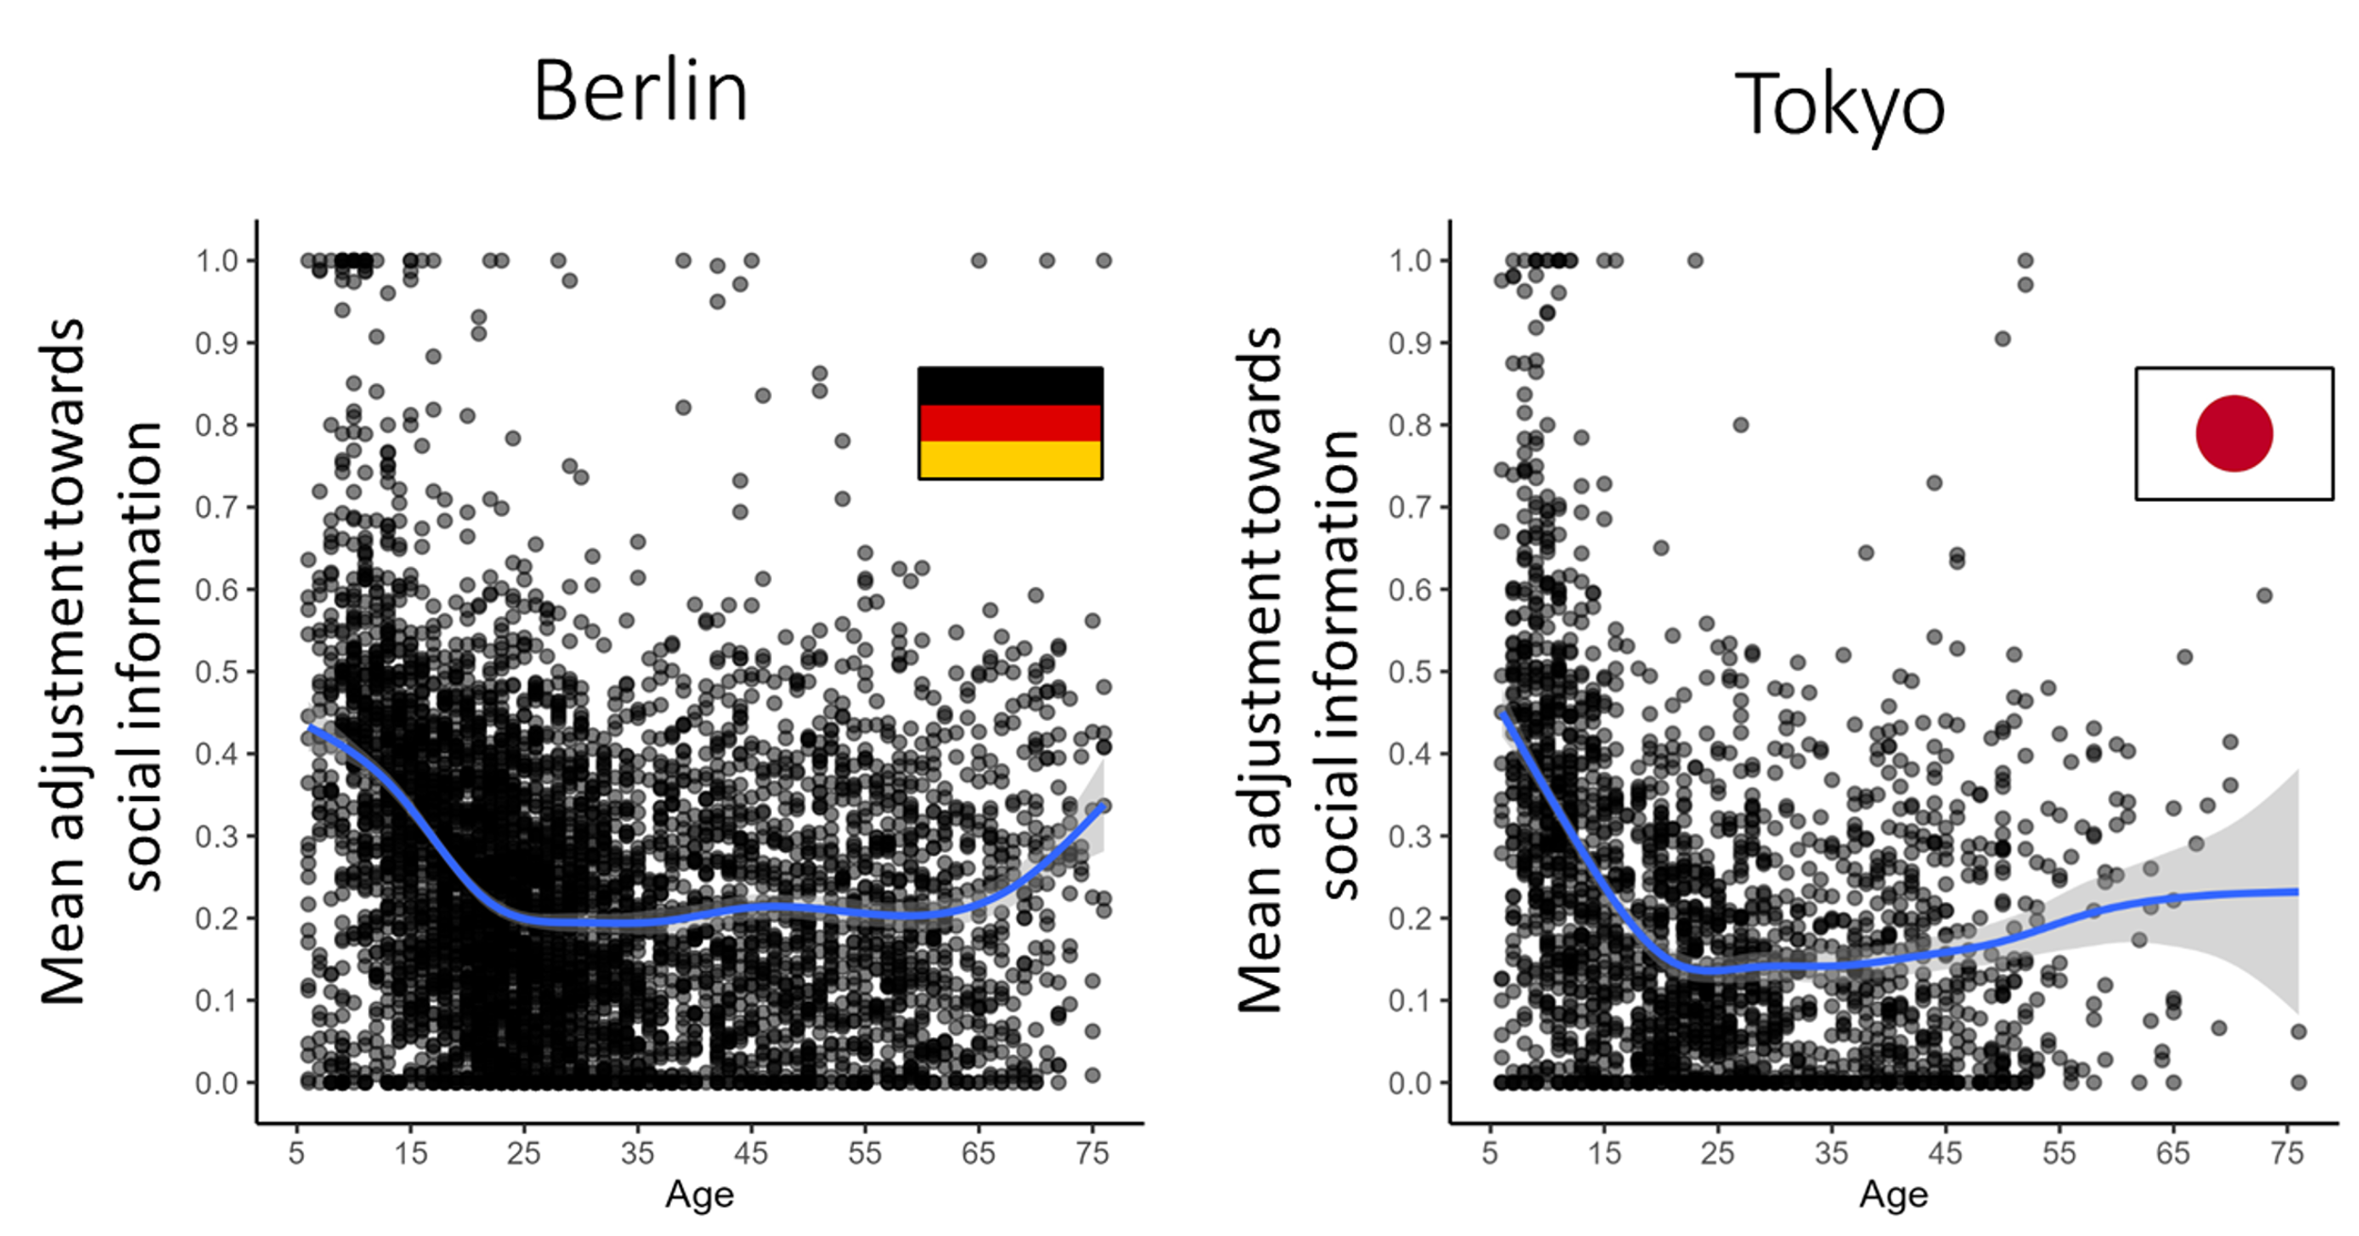
Higher social sensitivity compared to adults
Molleman et al., in prep.

Slide 7
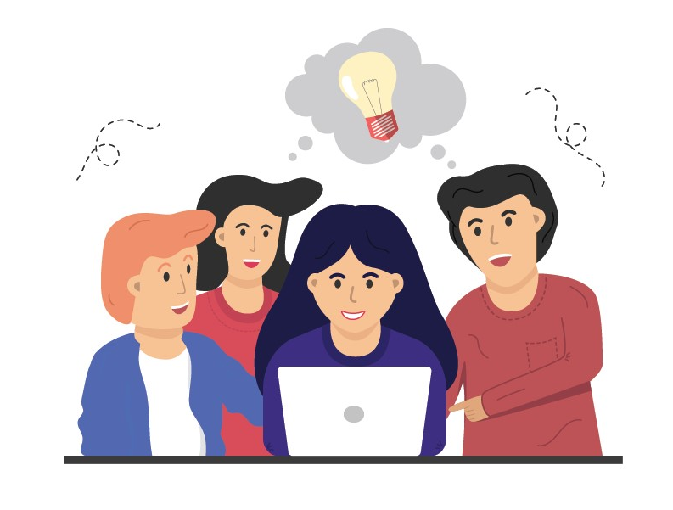
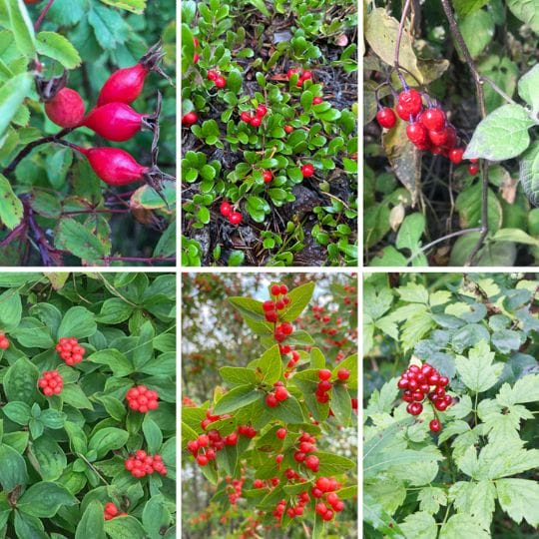
Social learning
Copying the behaviour of others to improve performance and avoid trial and error
Can be adaptive if the environment is uncertain or variable.
Deffner et al., 2020; Mehlhorn et al., 2015; Morgan et al., 2011
Notes:
We look at social influence from the perspective of social learning, i.e. ..this is a very abstract/biological view of SL

Slide 8
Environment structure
×
Social sensitivity
Notes:
So what is interesting about adolescence, is this unique combination of 1) expanding environment 2) realitevly high social sensitivity. What we ask in this study is,

Slide 9
Could sensitivity to social influence be adaptive during adolescence, allowing them to thrive in uncertain environments?
Environment structure
×
Social sensitivity
Notes:
So what is interesting about adolescence, is this unique combination of 1) expanding environment 2) realitevly high social sensitivity. What we ask in this study is,

Slide 11
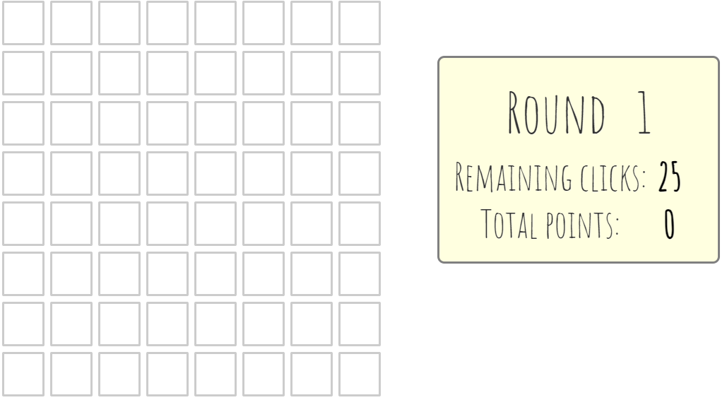
Notes:
We tried to condense this very abstract concept in an experiment

Slide 12
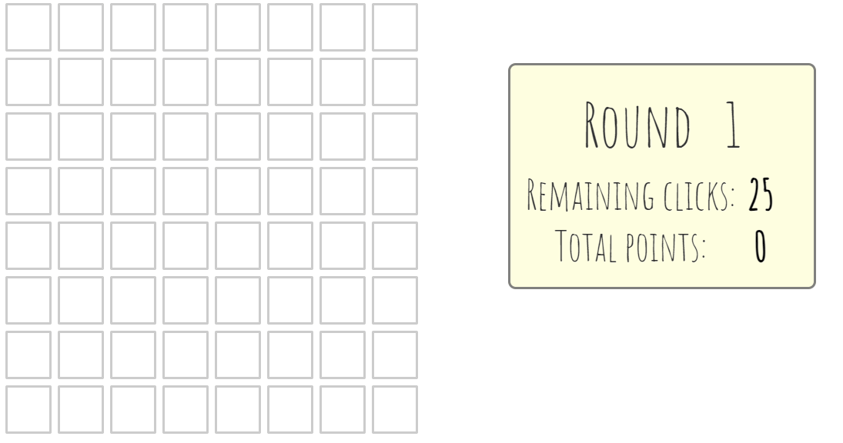
Notes:
2 things: first you don’t explore alone.

Slide 13
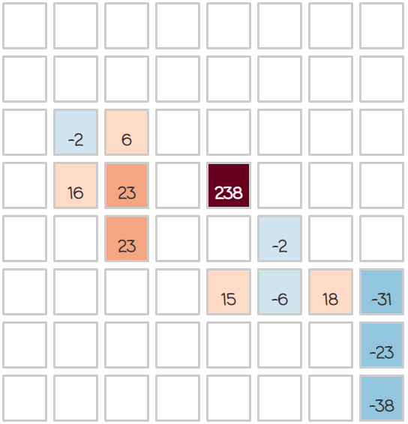
Notes:
Second there are incentives to explore

Slide 14
This is a gem!
Highly rewarding tiles,
that make exploration and risk-taking worth it.

Slide 15
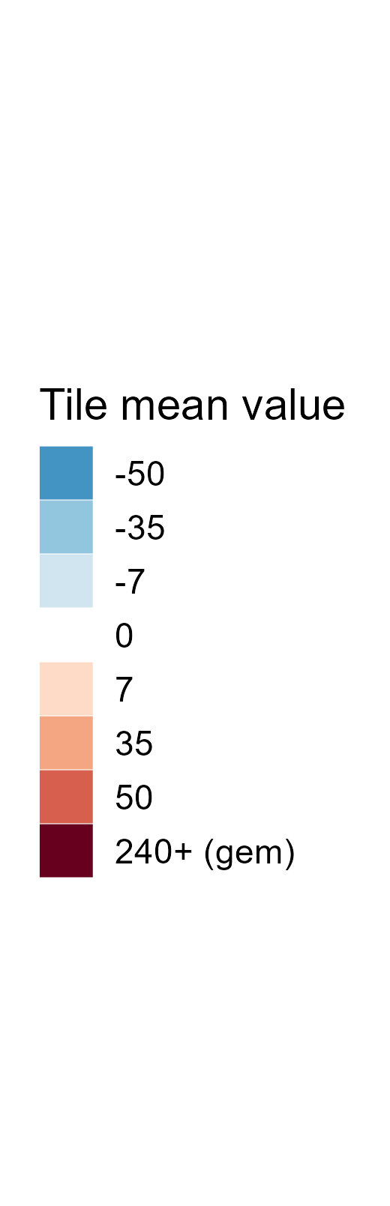
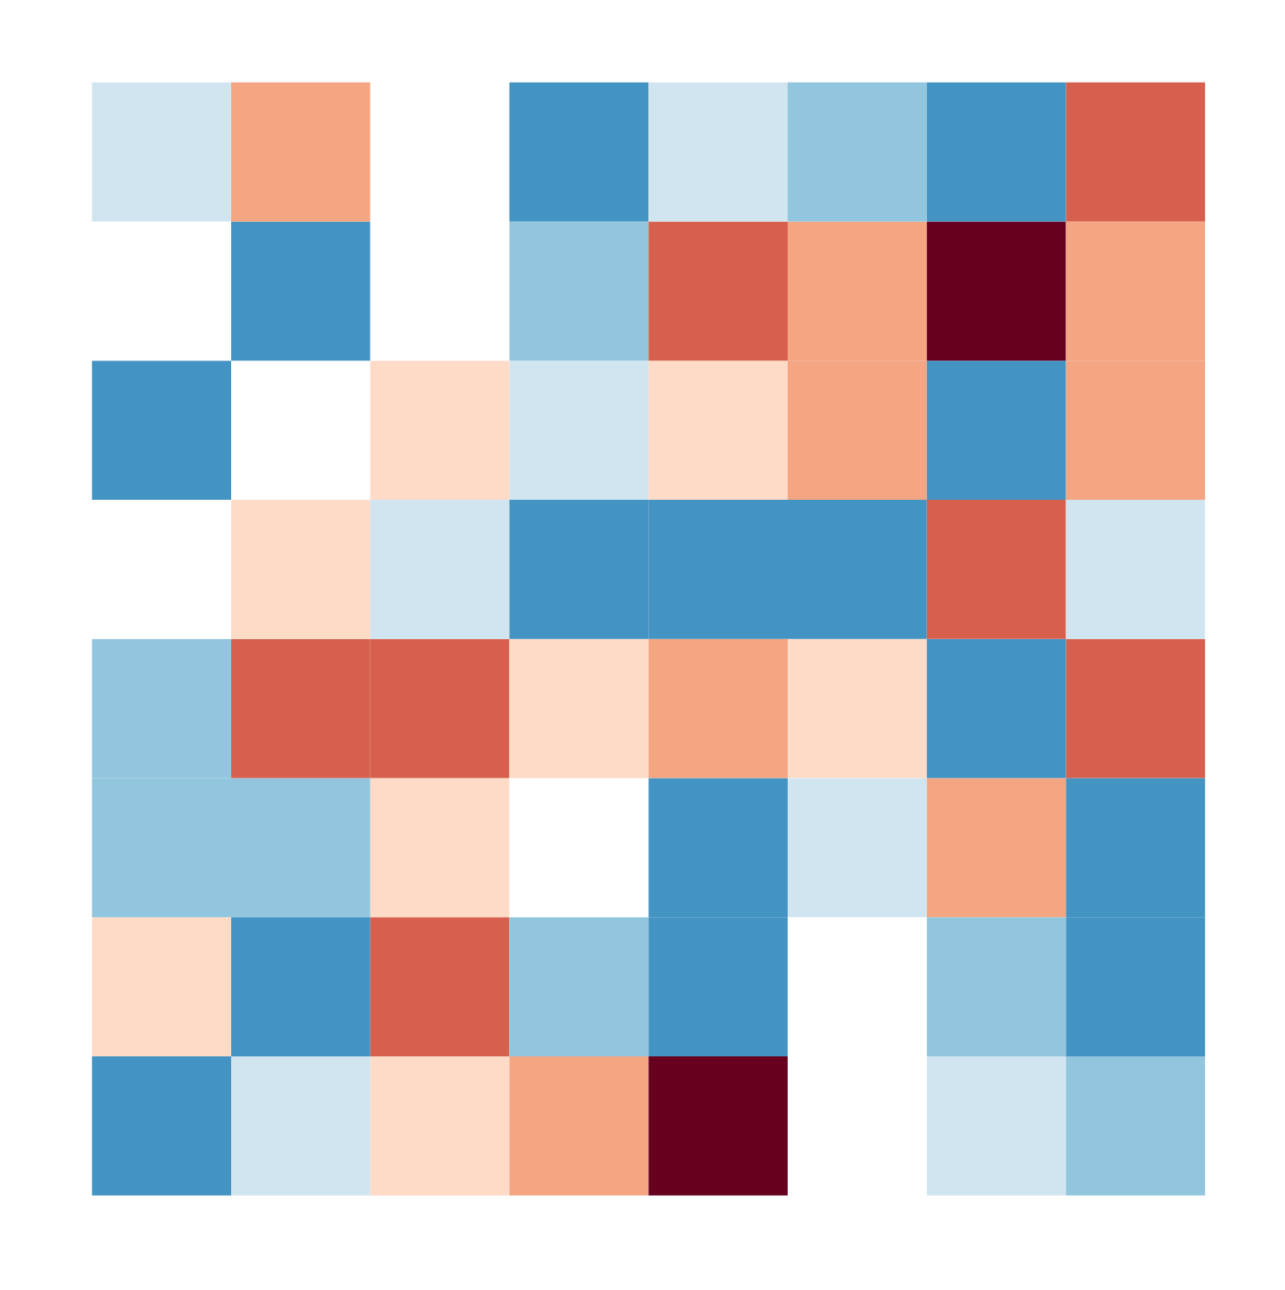
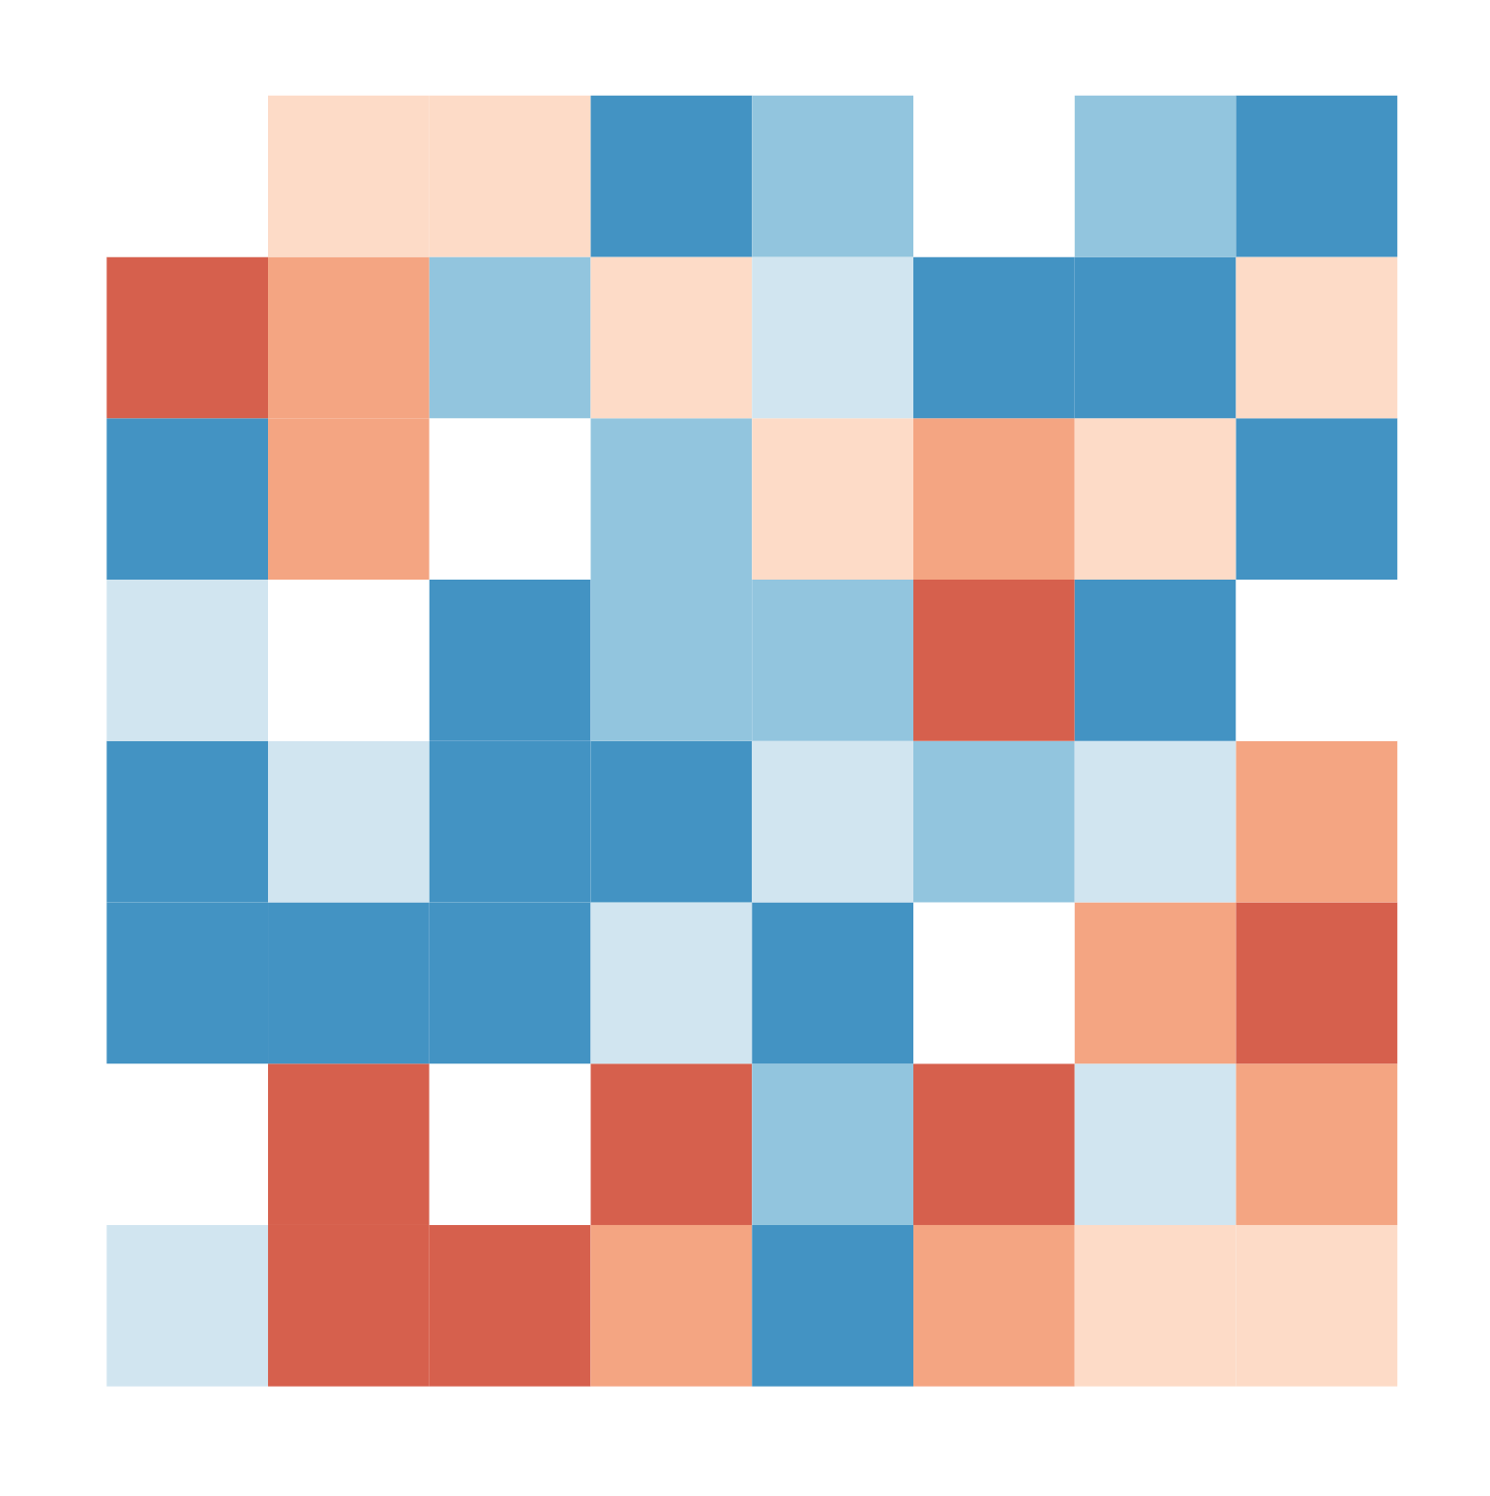
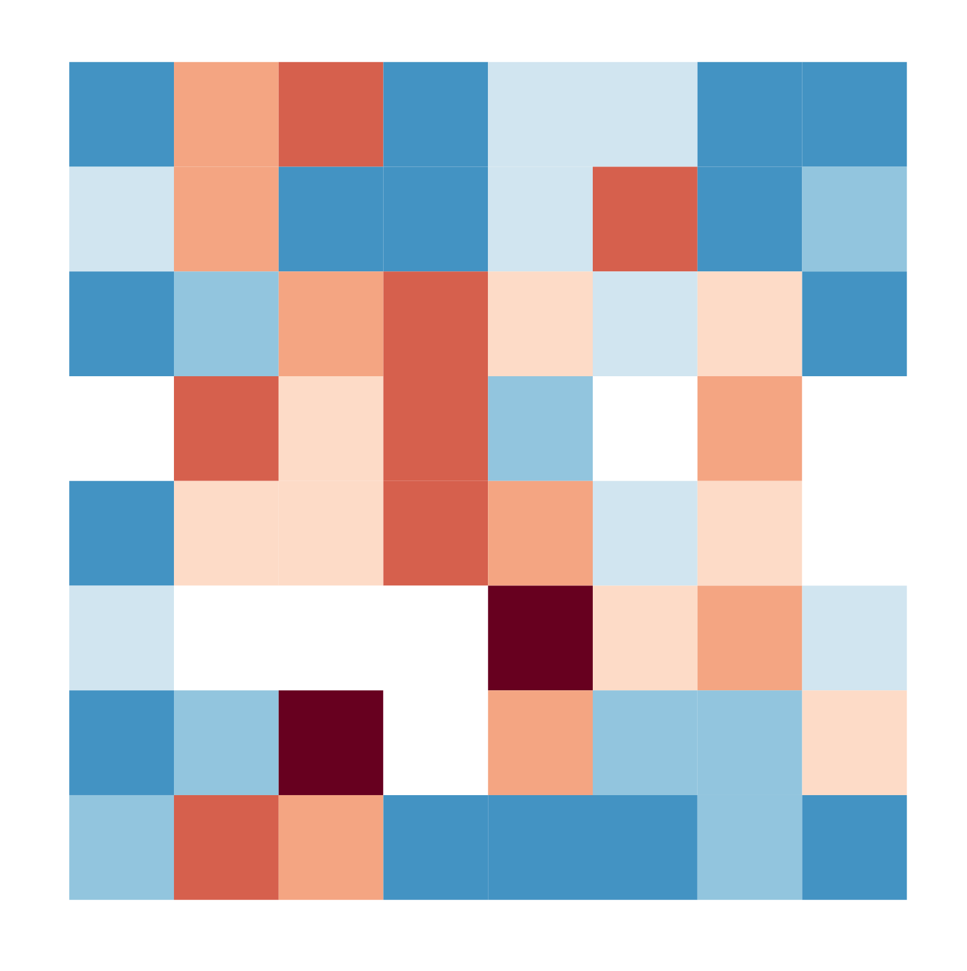
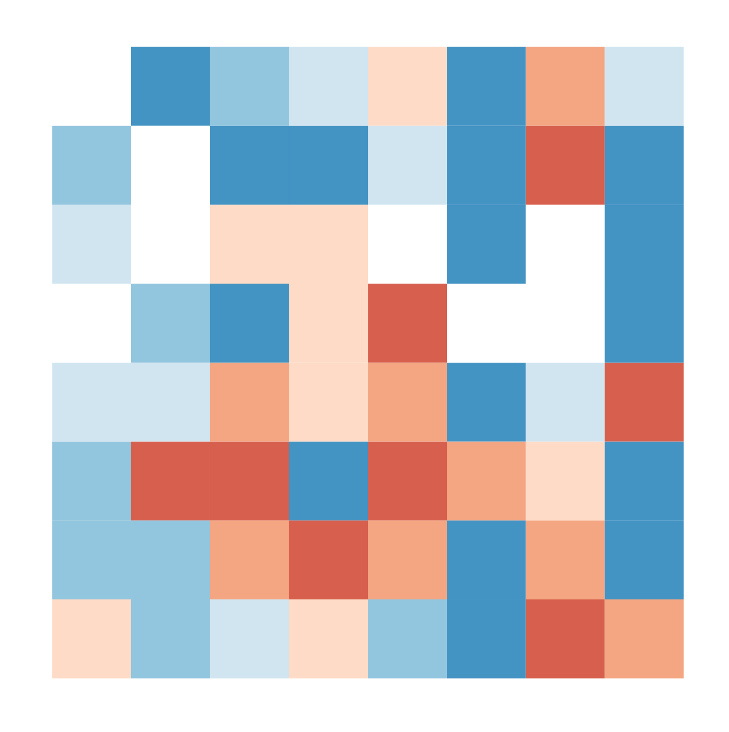
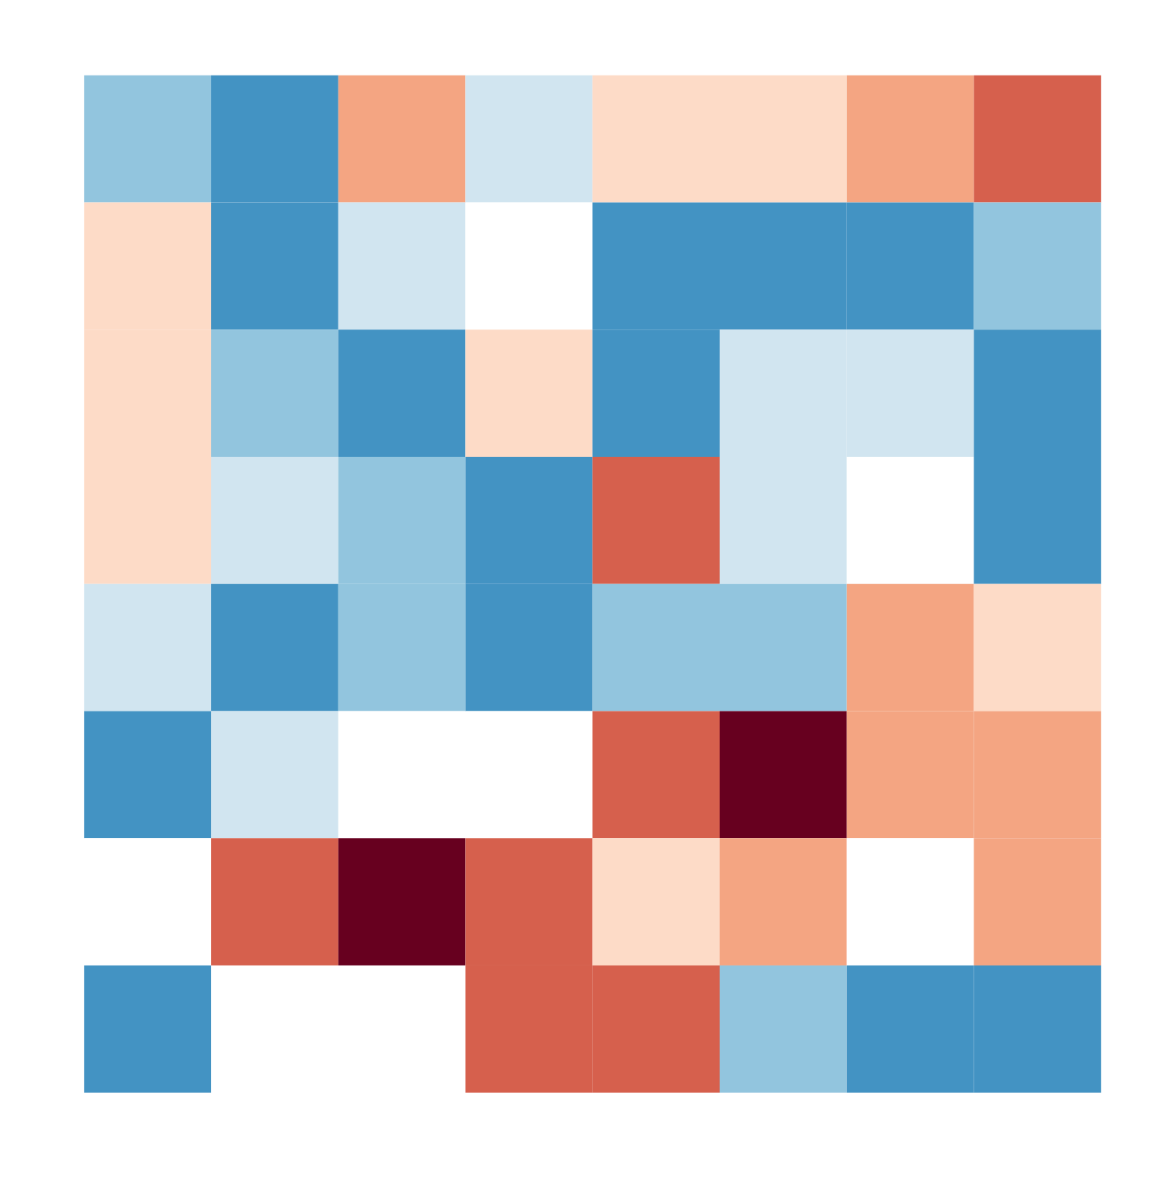
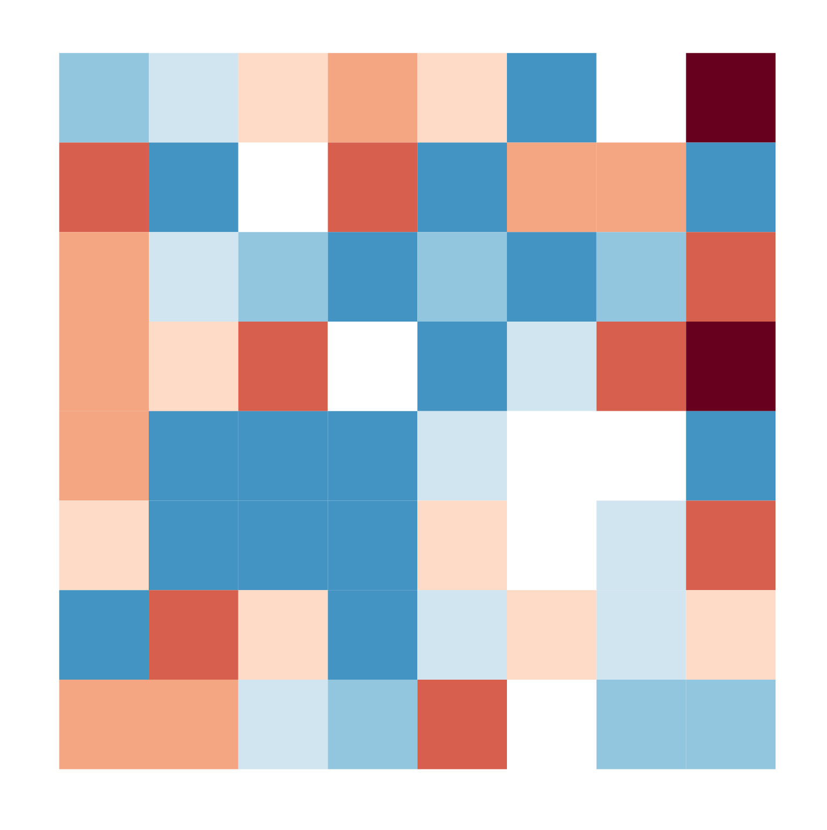
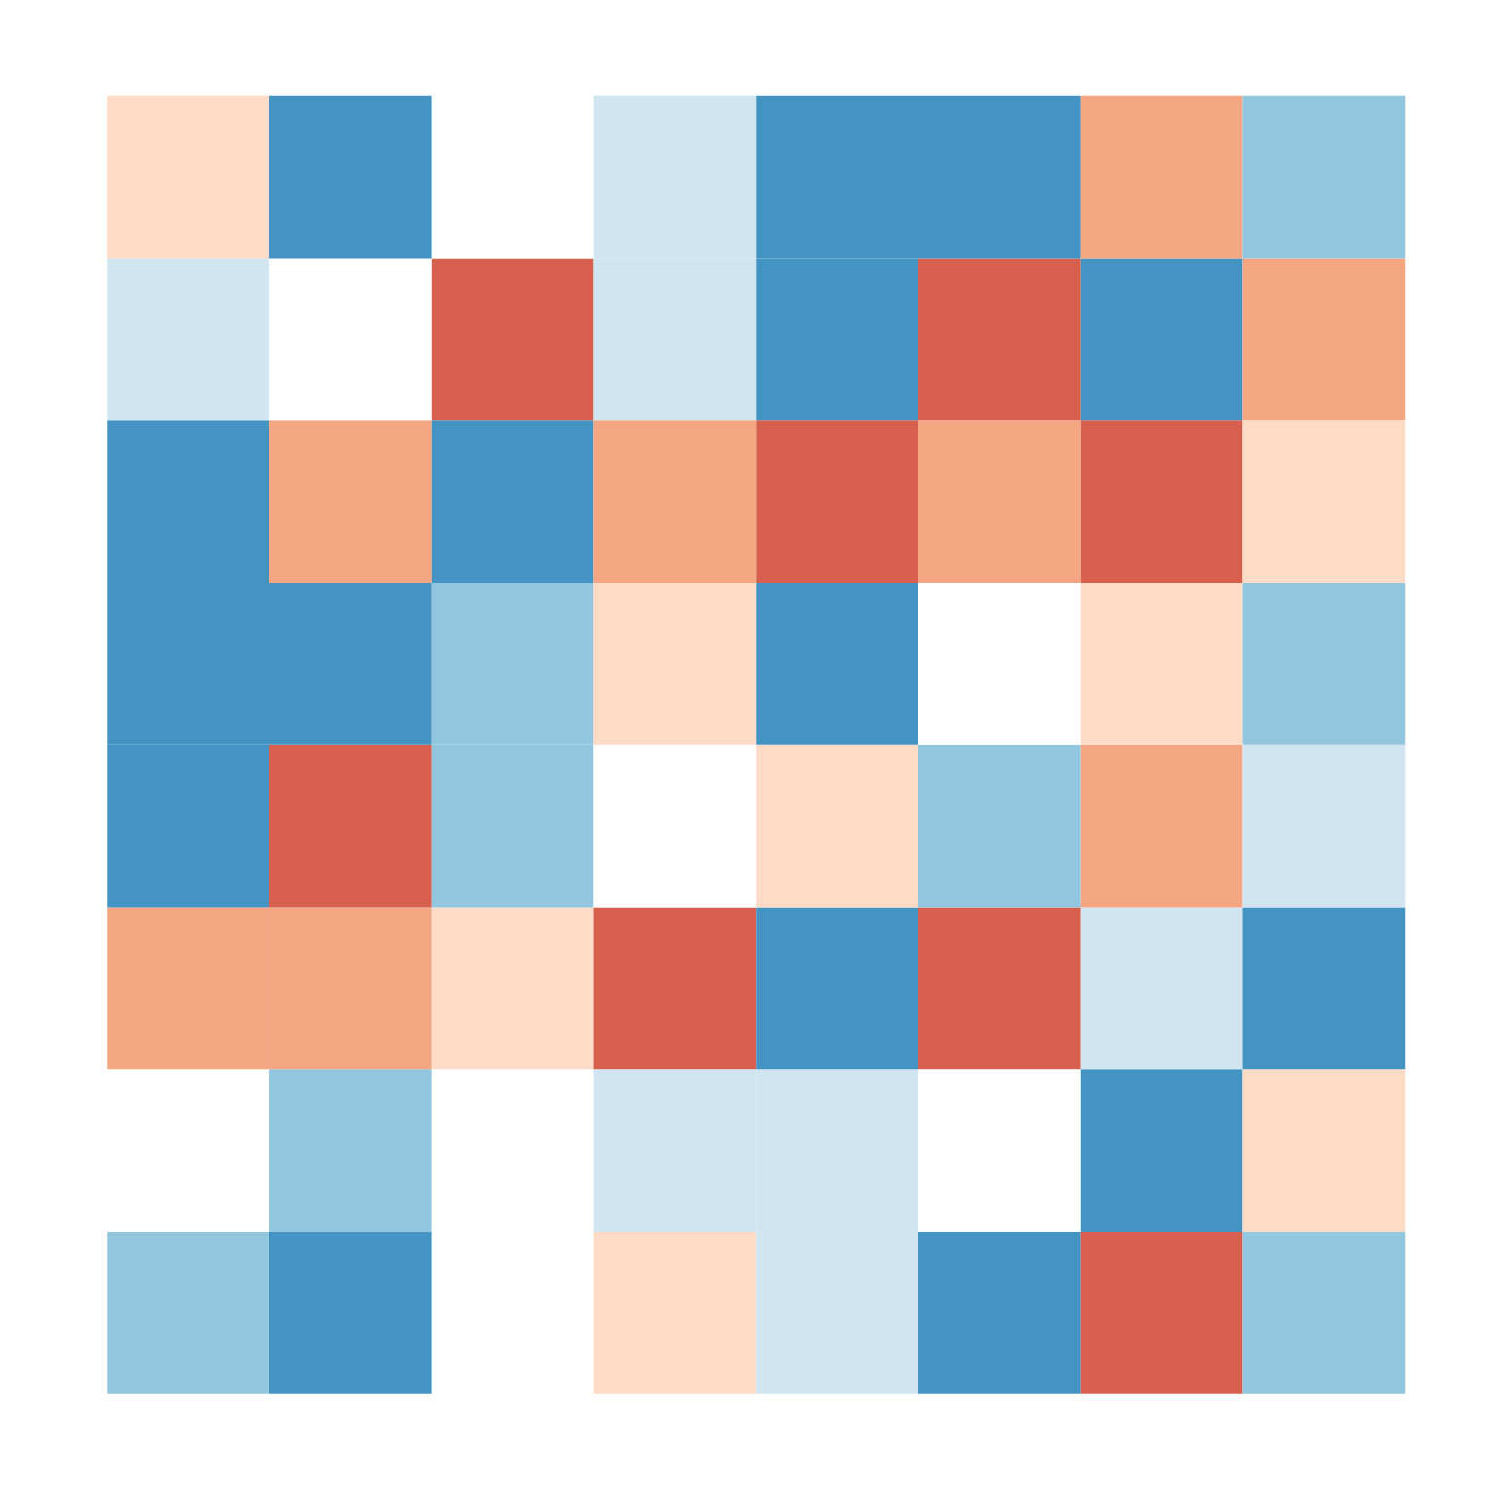

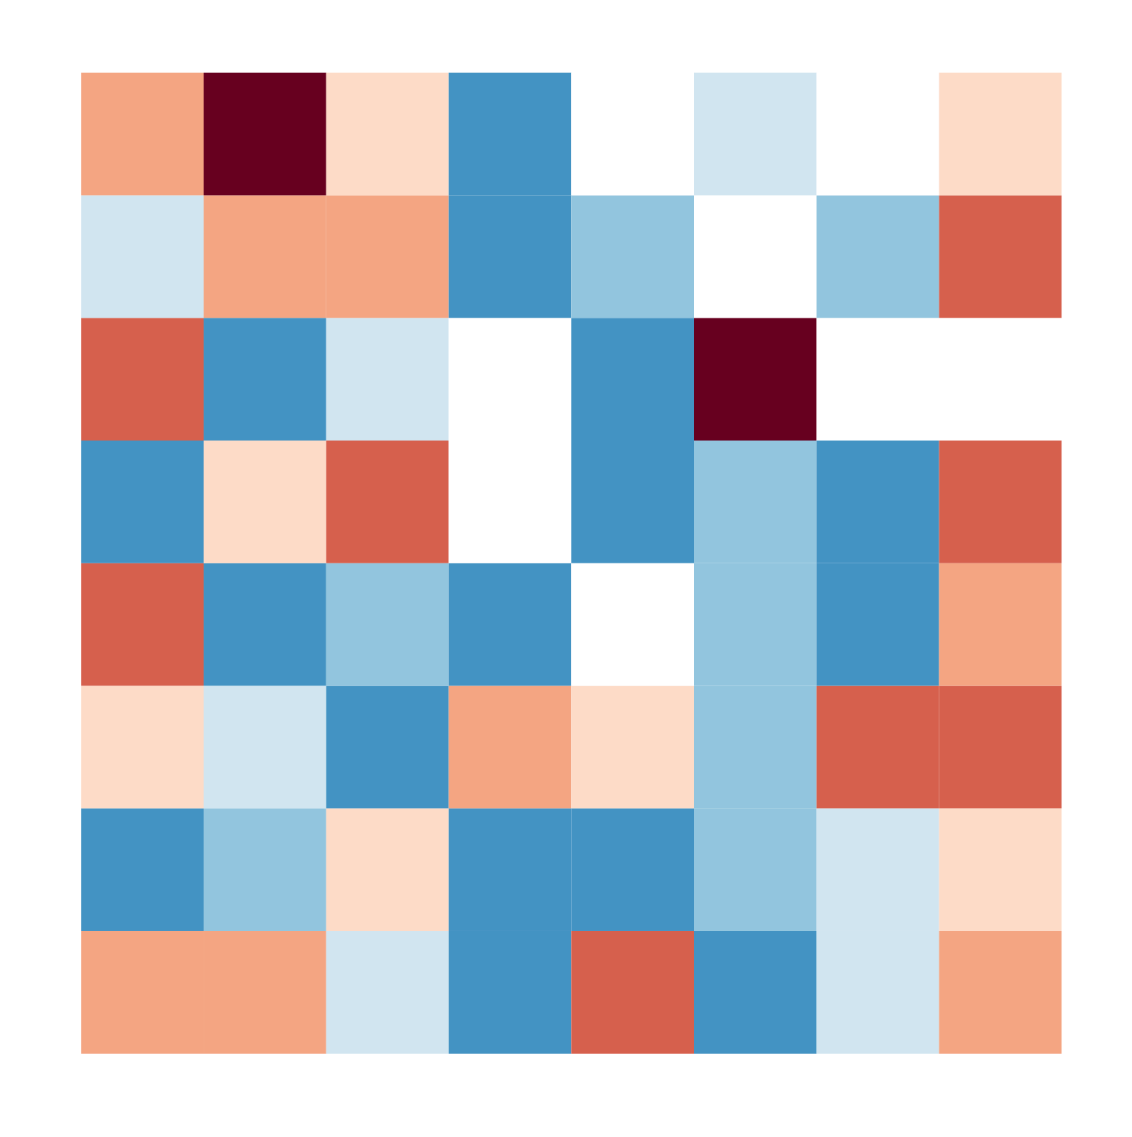
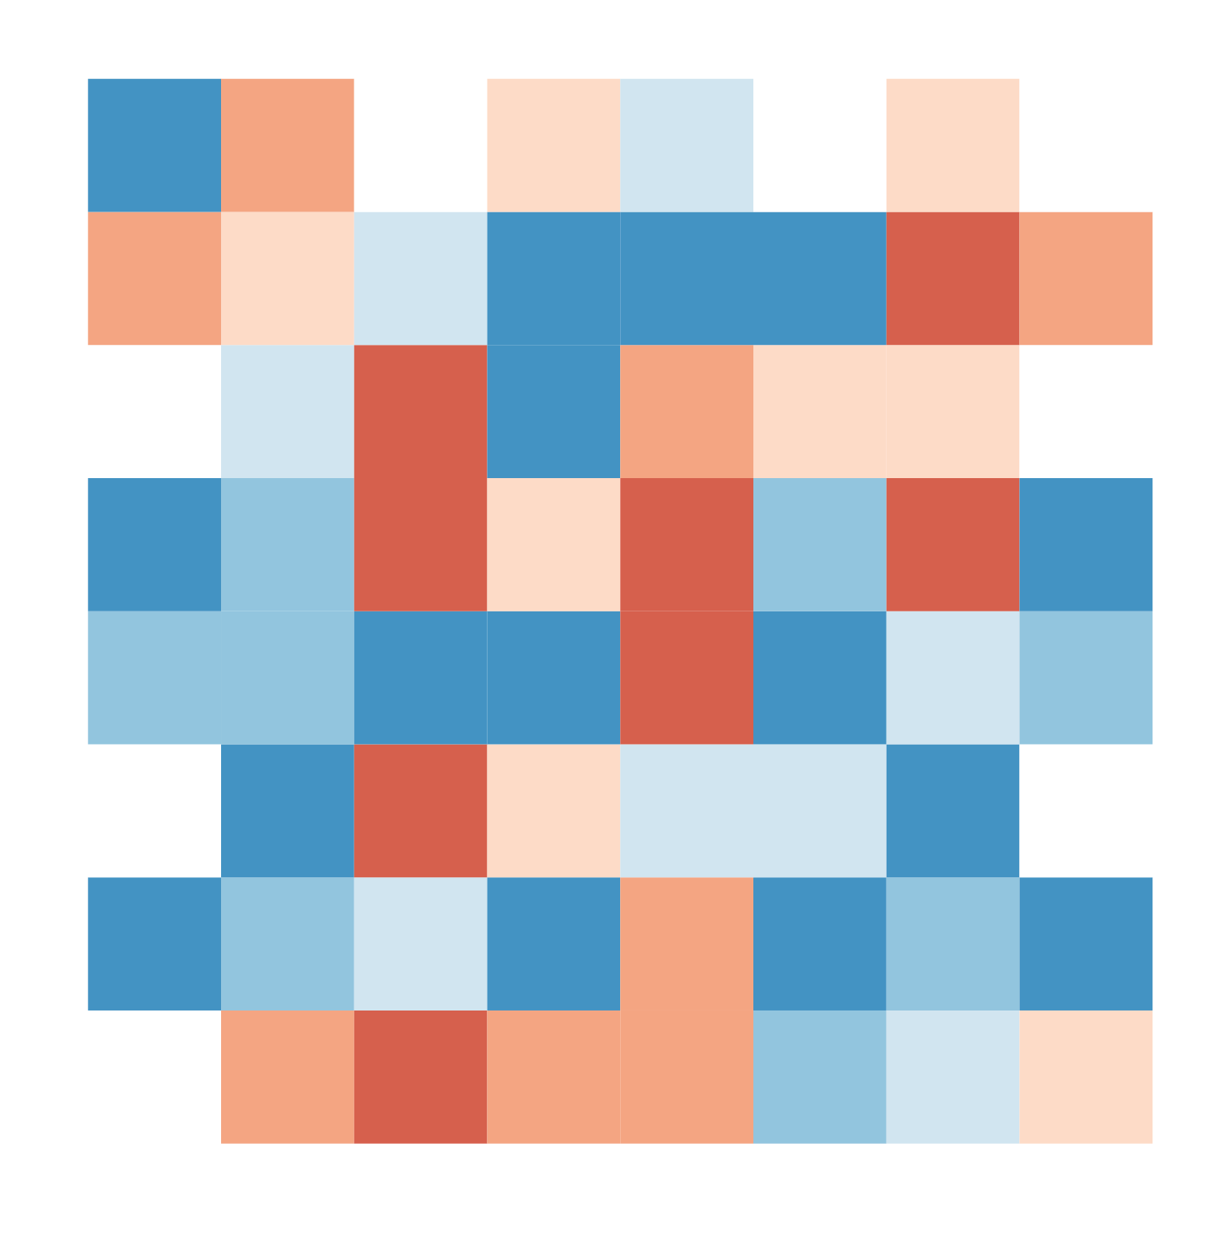


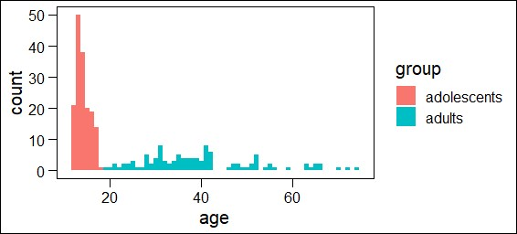
Experimental treatments
Quality of social information
(social source):
- High (Finds a gem)
- Medium (Exploits a non-gem)
- Low (Explores until the end)
Environments with gems (8)
Environments without gems (4)
N adolescents = 165
N adults = 110

Slide 16
Questions:
1. Can adolescents perform better than adults in this environment?
2. Do adolescents use more social information?
3. Are there group differences in using social information from different social sources?

Slide 17
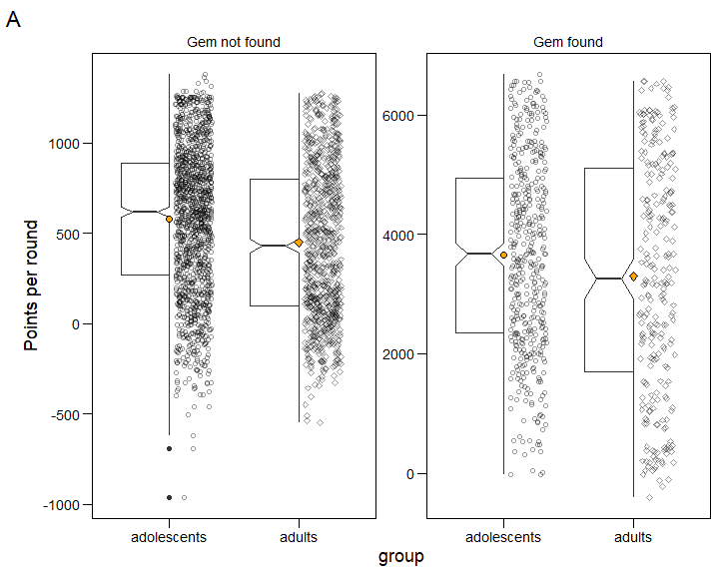
Result 1: performance
***
Adolescents score more points than adults across conditions and in both gem/non-gem environments.
Notes:
showing that adolescents perform better, or even equal to adults in behavioral task is very hard

Slide 18
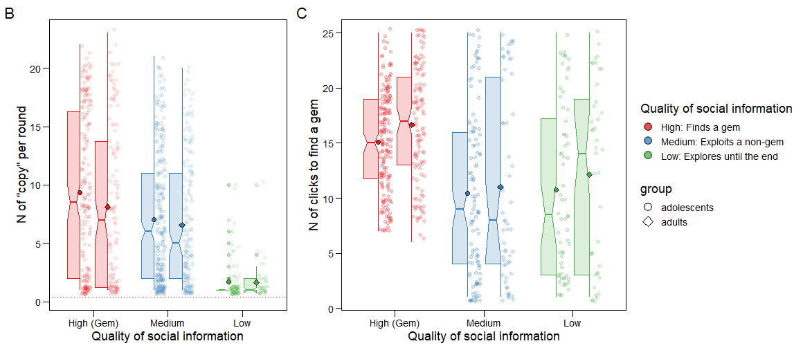
Result 2: social learning & exploration
Notes:
Are adolescents better at using the best social sources? We run statistical model to find if this is the case

Slide 19
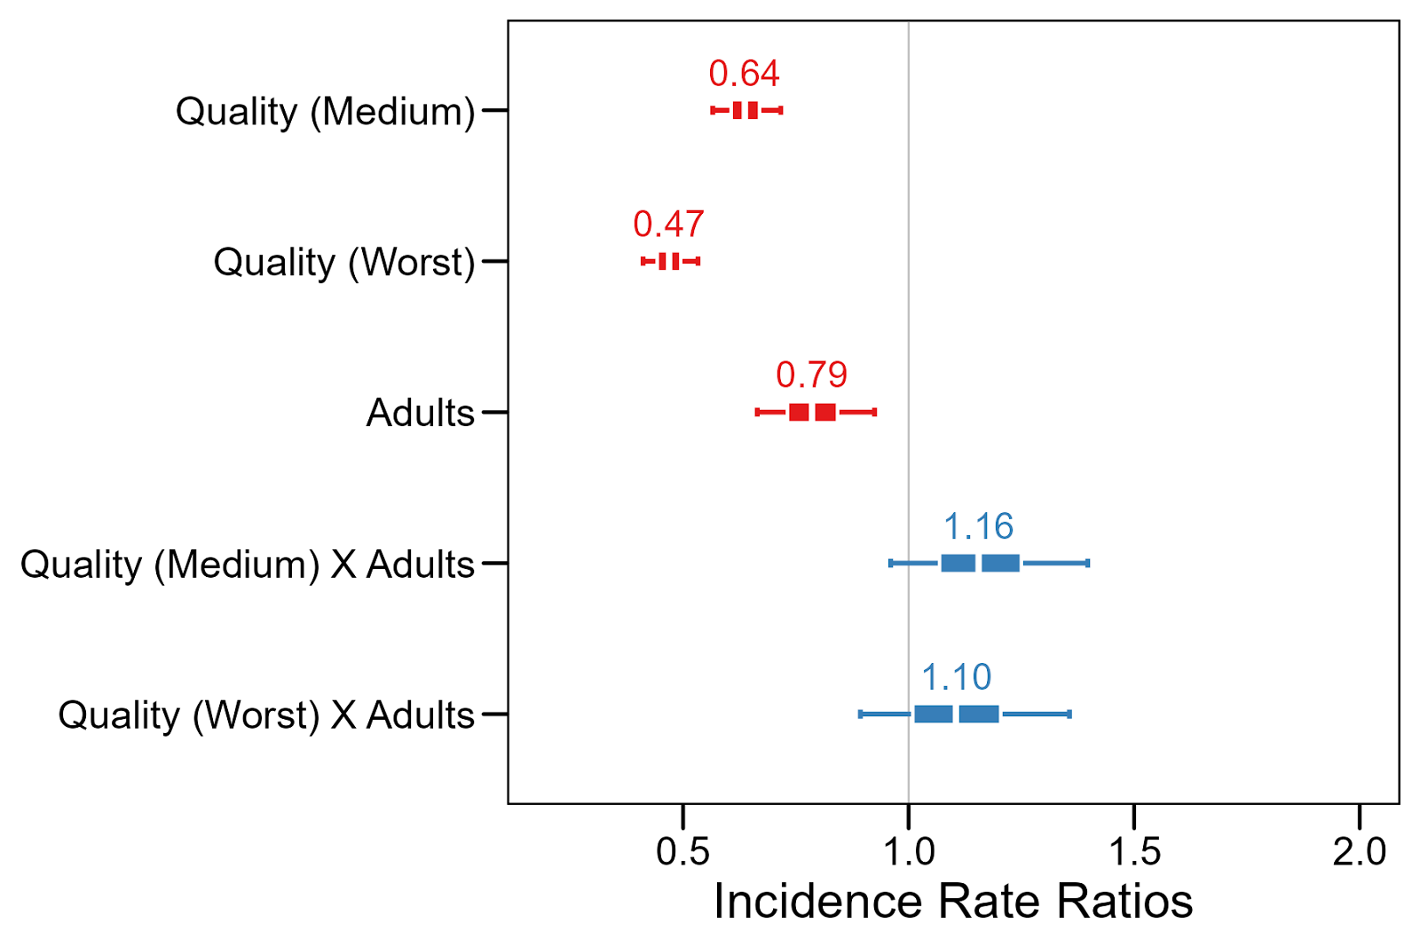
Results 2: regression results
Both groups are adaptive in social information use, but adults use less social information overall.

Slide 20
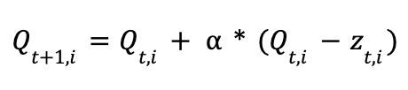
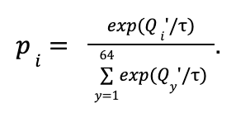
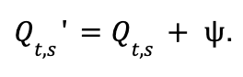
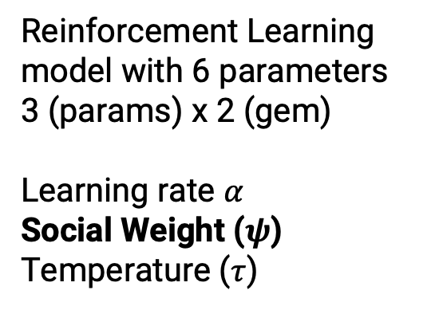
Computational modeling
The usual:
Reinforcement Learning model with 6 parameters
3 (params) x 2 (gem)
Learning rate $α$
Social Weight ($ψ$)
Temperature ($τ$)
The unusual:

Slide 21
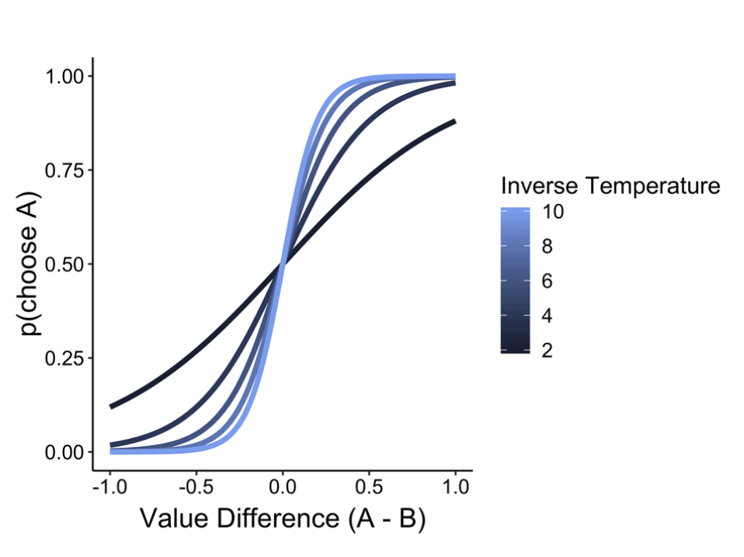
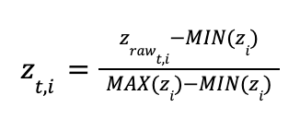
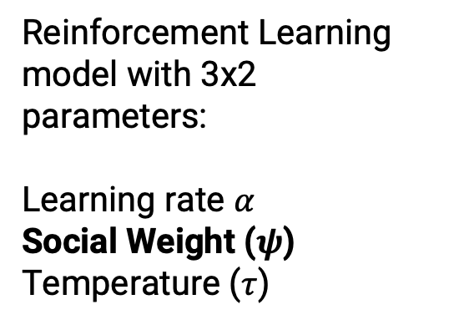
Computational modeling
The usual:
Reinforcement Learning model with 3x2 parameters:
Learning rate $α$
Social Weight ($ψ$)
Temperature ($τ$)
The unusual:

Slide 22
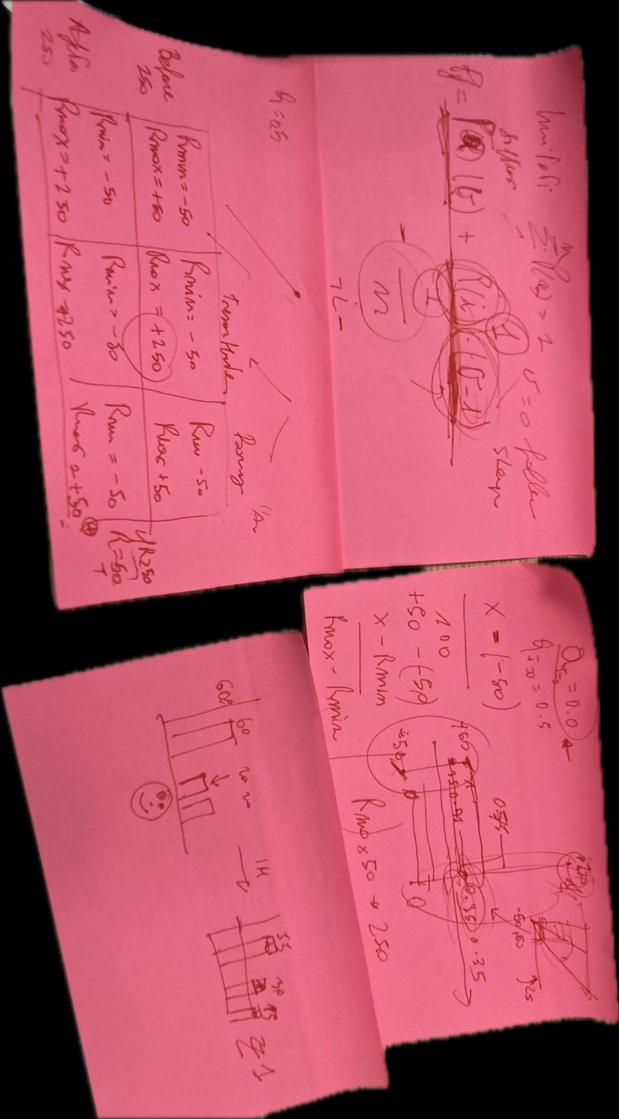
Computational modeling
The usual:
Reinforcement Learning model with 3x2 parameters:
Learning rate $α$
Social Weight ($ψ$)
Temperature ($τ$)
The unusual:

Slide 23
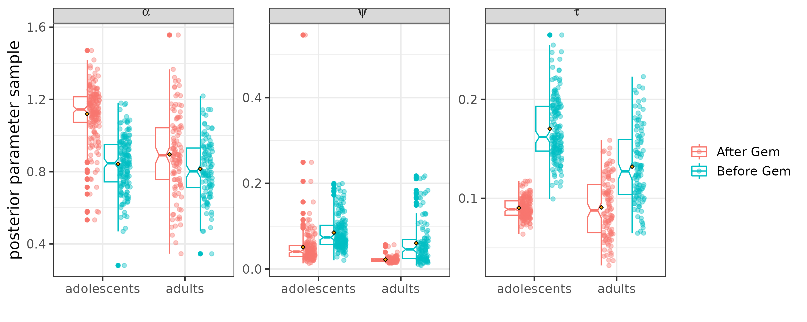
Computational modeling
The usual:
The unusual:
Social weight and temperature higher before gem
Social weight higher in adolescents.

Slide 24
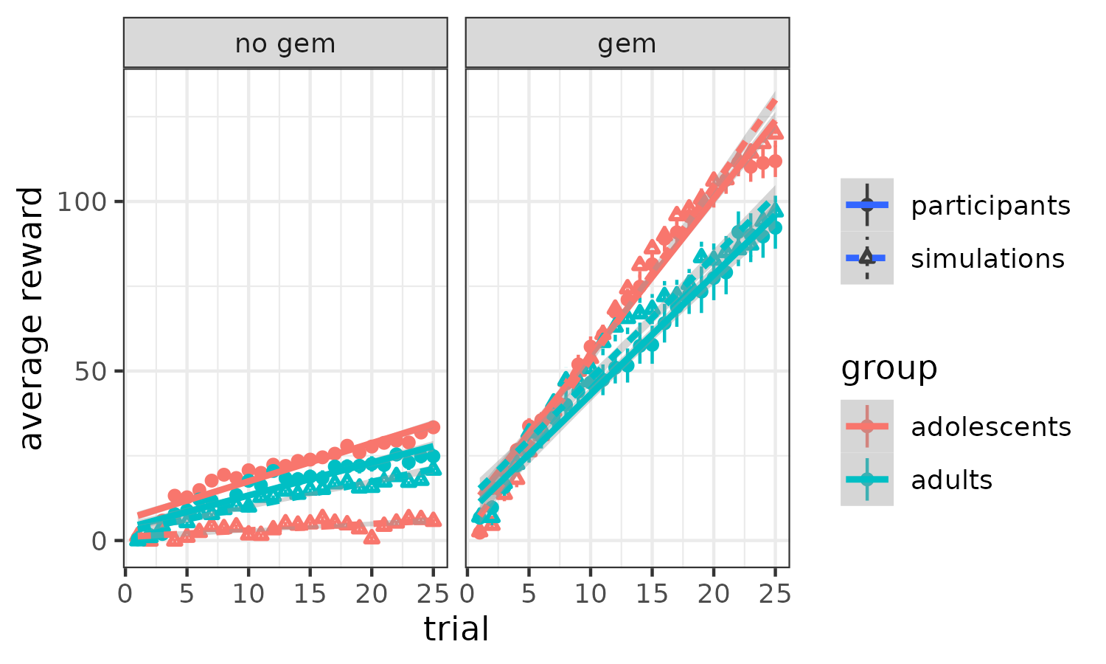
Computational modeling reproduces behavior (sort of)

Slide 25
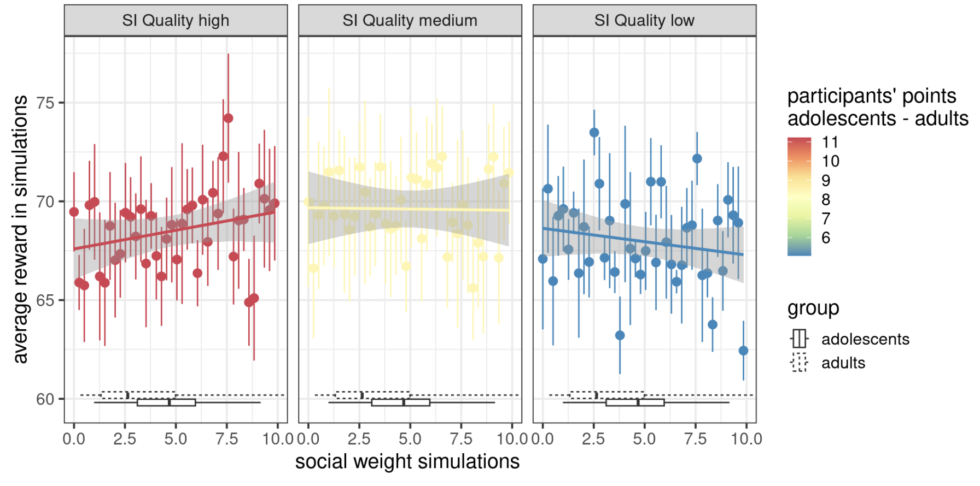
Simulations
Adolescents always score more than adults in this task, but too much social learning can become detrimental if social information quality is bad.

Slide 26
Summary
Adolescents:
1. Score more points
2. Find ‘gems’ earlier
3. Use more social information/have a larger social weight parameter across all treatments
Notes:
Before results: showing that adolescents perform better, or even equal to adults in behavioral task is very hard

Slide 27
Take away message
By copying others more, adolescents were able to find ‘gems’ earlier, and thus score more points.
Higher social sensitivity helped adolescents perform better…
…but it all depends (on the environment and the social source)
Notes:
Kind of a dense title so let me unpack a little bit the concept

Slide 28


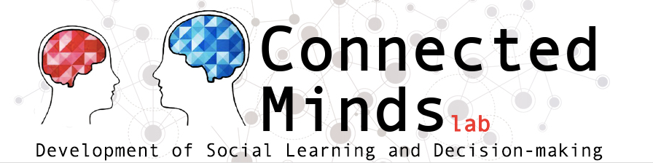

Thank you!
Wouter van den Bos
Simon Ciranka
Lucas Molleman

Slide 29
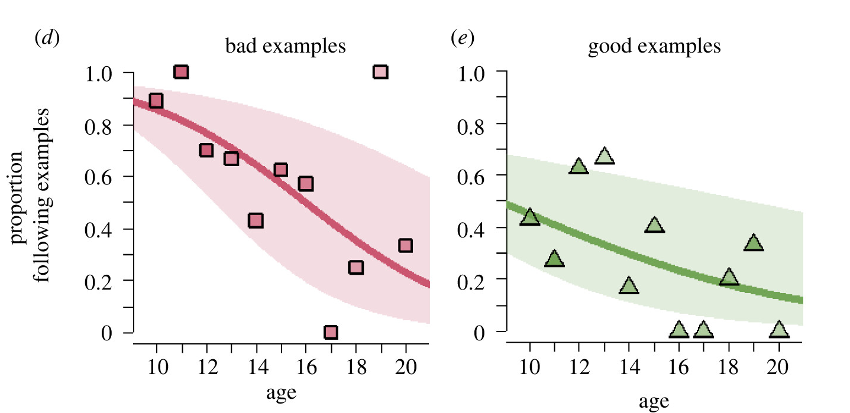
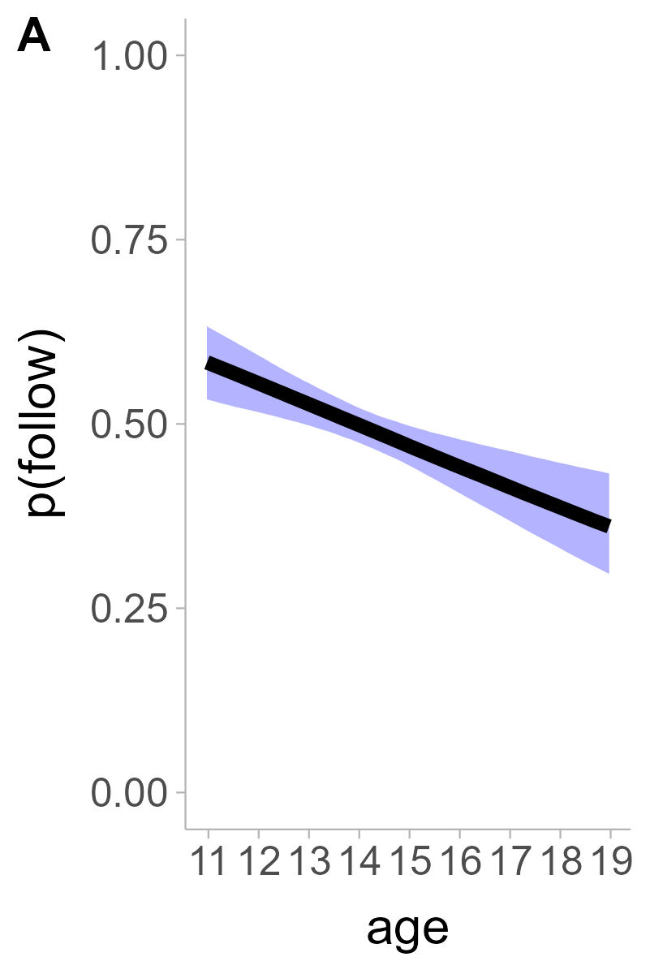
Social learning declines from childhood to adulthood
Notes:
Trajectory inverse to experience

